Slide 1
jQuery mobile
Why? Because in your real job, you will have new libraries of existing code thrown at you that you need to learn on the fly, which is what I am doing to you now.

Slide 2
What is jQuery Mobile?
jQuery mobile is a framework created for making platform independent mobile applications using HTML5, CSS3, and jQuery.
See: http://www.codeproject.com/Articles/644118/Writing-your-first-jQuery-Mobile-app-Part
jQuery Mobile can help in the following circumstances:
Different screen sizes, pixel densities (DPI) and orientations;
Different compatibility in terms of HTML5 and CSS3;
New platforms appearing every couple of months
Dozens of hacks that we need to implement for each platform and to update almost every couple of months when a new browser appears.
See: https://www.smashingmagazine.com/2013/03/getting-started-jquery-mobile/

Slide 3
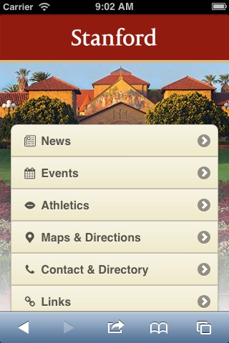
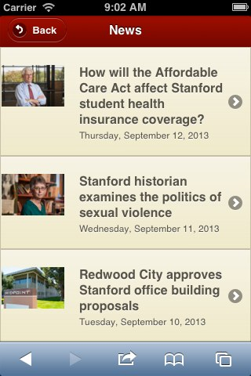
jQuery Mobile: Make it portable and UI friendly

Slide 4
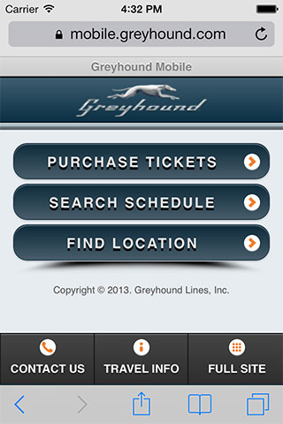
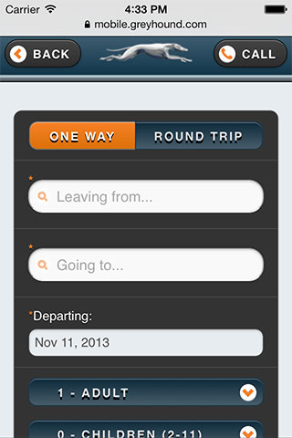
jQuery Mobile: Make it portable and UI friendly
And the world famous: http://kurt-jquerymobile.azurewebsites.net/

Slide 5
What is jQuery Mobile?
jQuery mobile is a framework created for making platform independent mobile applications using HTML5, CSS3, and jQuery.
jQuery mobile uses HTML5 extensively so need:
<!DOCTYPE html>
load the jQuery mobile framework in head section. We’ll use the CDN enabled links for better performance.
<link rel="stylesheet" type="text/css" href="http://code.jquery.com/mobile/1.3.1/jquery.mobile-1.3.1.min.css"/>
<script src="http://code.jquery.com/jquery-1.8.2.min.js"></script>
Note many of these articles are using ver 1.3.1, which is old. And of course they beak things as they go to later versions. Just be careful if you are using an article or cutting code from a project that the version numbers are consistent, or be prepared to do some investigations and changing.

Slide 6
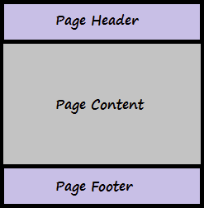
jQuery Mobile : body of the page
The page structure of jQuery mobile app has 3 sections "Header", "Content" and "Footer". They are all simple <div> containers, styled by using the HTML 5 data-role attributes.
As a SPA (single page application), our one downloaded HTML file can contain multiple “pages”, but these pages are really multiple, different page “blocks”, where pages are nothing but <div> elements with other HTML 5 data attributes.
<div data-role="page">
<div data-role="page">
<div data-role="page">
<div data-role="header">
“home/ display data page”
“edit data page”
“delete data page”
<div data-role=“content">
<div data-role=“footer">

Slide 7
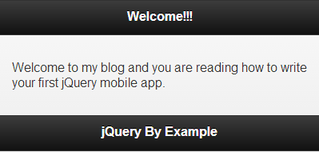
One “page” with its 3 parts
<!DOCTYPE html>
<html>
<head>
<meta name="viewport" content="width=device-width, initial-scale=1">
<title>My First jQuery Mobile Application</title>
<link rel="stylesheet" type="text/css" href="http://code.jquery.com/mobile/1.3.1/jquery.mobile-1.3.1.min.css"/>
<script src="http://code.jquery.com/jquery-1.8.2.min.js"> </script>
<script src="http://code.jquery.com/mobile/1.3.1/jquery.mobile-1.3.1.min.js"></script>
</head>
<body>
<div data-role="page">
<div data-role="header">
<h1>Welcome!!!</h1>
</div>
<div data-role="content">
<p>Welcome to my blog and you are reading how to write your first jQuery mobile app.</p>
</div>
<div data-role="footer">
<h1>jQuery By Example</h1>
</div>
</div>
</body>
</html>

Slide 8
Theme’s, icons
Has built in 5 themes (a, b, c, d, e), sets of consistent shapes, colors, etc.
Just add:
<div data-role="header" data-theme='b'>
And you can define your own
As well as buttons with icons:
<a href="Home.html" data-icon="home">Home</a>
That will be a button that takes you to a page called Home, which we will have to add as another tagged <div>
<div data-role="page">
See this site for an on-line “play with it”:
http://jsbin.com/ORiREzu/11/edit?html,output

Slide 9
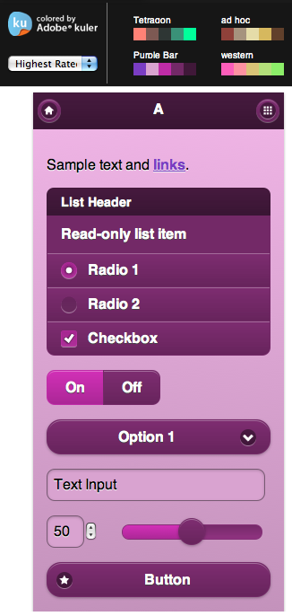
jquery mobile theme roller
https://learn.jquery.com/jquery-mobile/theme-roller/

Slide 10
mobile jQuery
http://jquerymobile.com/
Suggest you use this:
https://www.tutorialspoint.com/jquery_mobile/index.htm
And official documentation
http://api.jquerymobile.com/
But we will just jump into a sample program that will get you there fast.

